Slide 1
House Committee on Healthcare Reform Testimony
Roger Moczygemba MD MHA

Slide 2
My background
Former innovative models that create affordable access to care
Nationwide Telemedicine
Founding President of the Teladoc Physicians Association (2004-2013)
Founding Consultant and Medical Director of DialCare (2016-2021)
Recuro Health Medical Director (2022)
Notes:
I sincerely appreciate the opportunity to address this committee. To the extent that we have a shared desire to increase access to affordable healthcare in Texas, I hope and pray that my presentation will be insightful. From 2004 to 2013 I was the founding president of the Teladoc Physician’s Association. I mention this because it started as direct care membership model offered to employers. From 2016 to 2021 I was the founding consultant and medical director of DialCare which is another nationwide telemedicine program that is a direct care model offered through employers.

Slide 3
My background
B. Founder of Direct Med Clinic
C. Founder of the San Antonio Chapter of the Free Market Medical Association
Winner of the Beacon Award/Chapter of the year 2022
Notes:
What I will share today comes from my experience as founder of Direct Med Clinic, a Direct Primary Care practice. I am also founder of the San Antonio chapter of the Free Market Medical Association which won the Beacon Award and chapter of the year this year. We do not have a free market in healthcare without price transparency. In San Antonio, we are creating a free healthcare market.

Slide 4
II. Issues I will address
Reaching low income, at-risk population
Affordability
Access to care (not access to insurance)
Transparency
Notes:
The issues from your creation proclamation that I will address are:
reaching the the low income, at-risk population,
affordability,
access to care (not insurance)
and transparency.
I have addressed these issues for a number of Texans through the principles of direct care and direct contracting augmented by a free healthcare market which can only be achieved with transparency.

Slide 5
III. Results of current innovative care model
Results for a mid-sized employer
June 1, 2020 - May 31, 2021
Average enrollment = 618 patients (including dependents)
Notes:
The following is a case study in which Direct Med Clinic provided affordable access to a mid-sized employer. We are in the the third year of duplicating these results for this employer.

Slide 6
Notes:
You might know that a doctor’s office can directly contract with a lab. Pricing for labs is much lower for a doctor’s office than it is for an insurance company. This slide is an example of the 6 most common labs drawn for this employer over a year with a comparison of the traditional cost through insurance and the cost of the lab billed to Direct Med Clinic. It shows the number of tests multiplied by the traditional cost through an insurance company compared to the cost the employer paid through Direct Med Clinic. You can see that we saved the employer 96% on the cost of these labs.

Slide 7
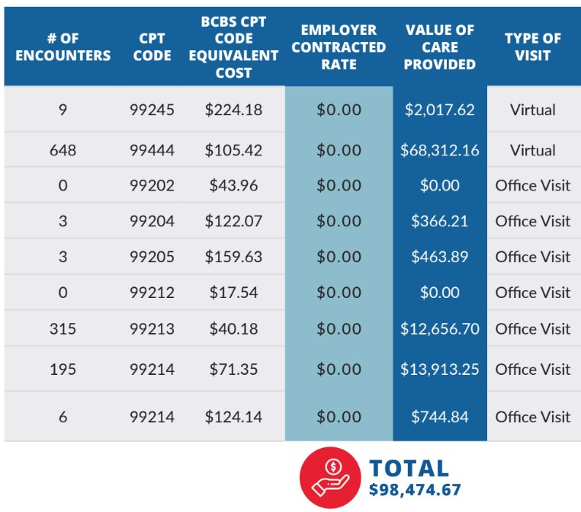
OFFICE VISITS
Notes:
This slide shows the COST of care provided if it would have been billed on a fee for service basis to an insurance company.

Slide 8
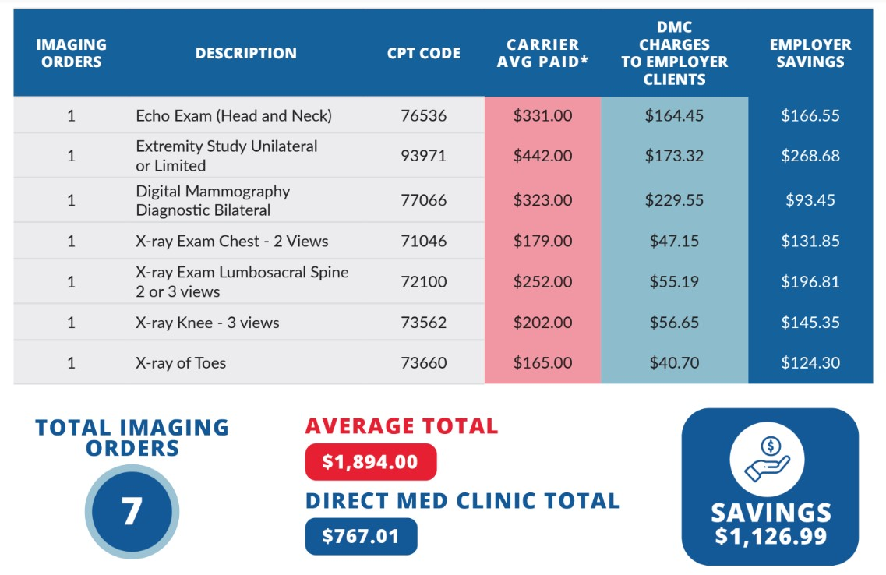
IMAGING
Notes:
Through direct contracting with imaging facilities DPC docs can save their patients money on imaging. Direct Med Clinic has negotiated direct pay rates for imaging which we then pass on to the the employer.

Slide 9
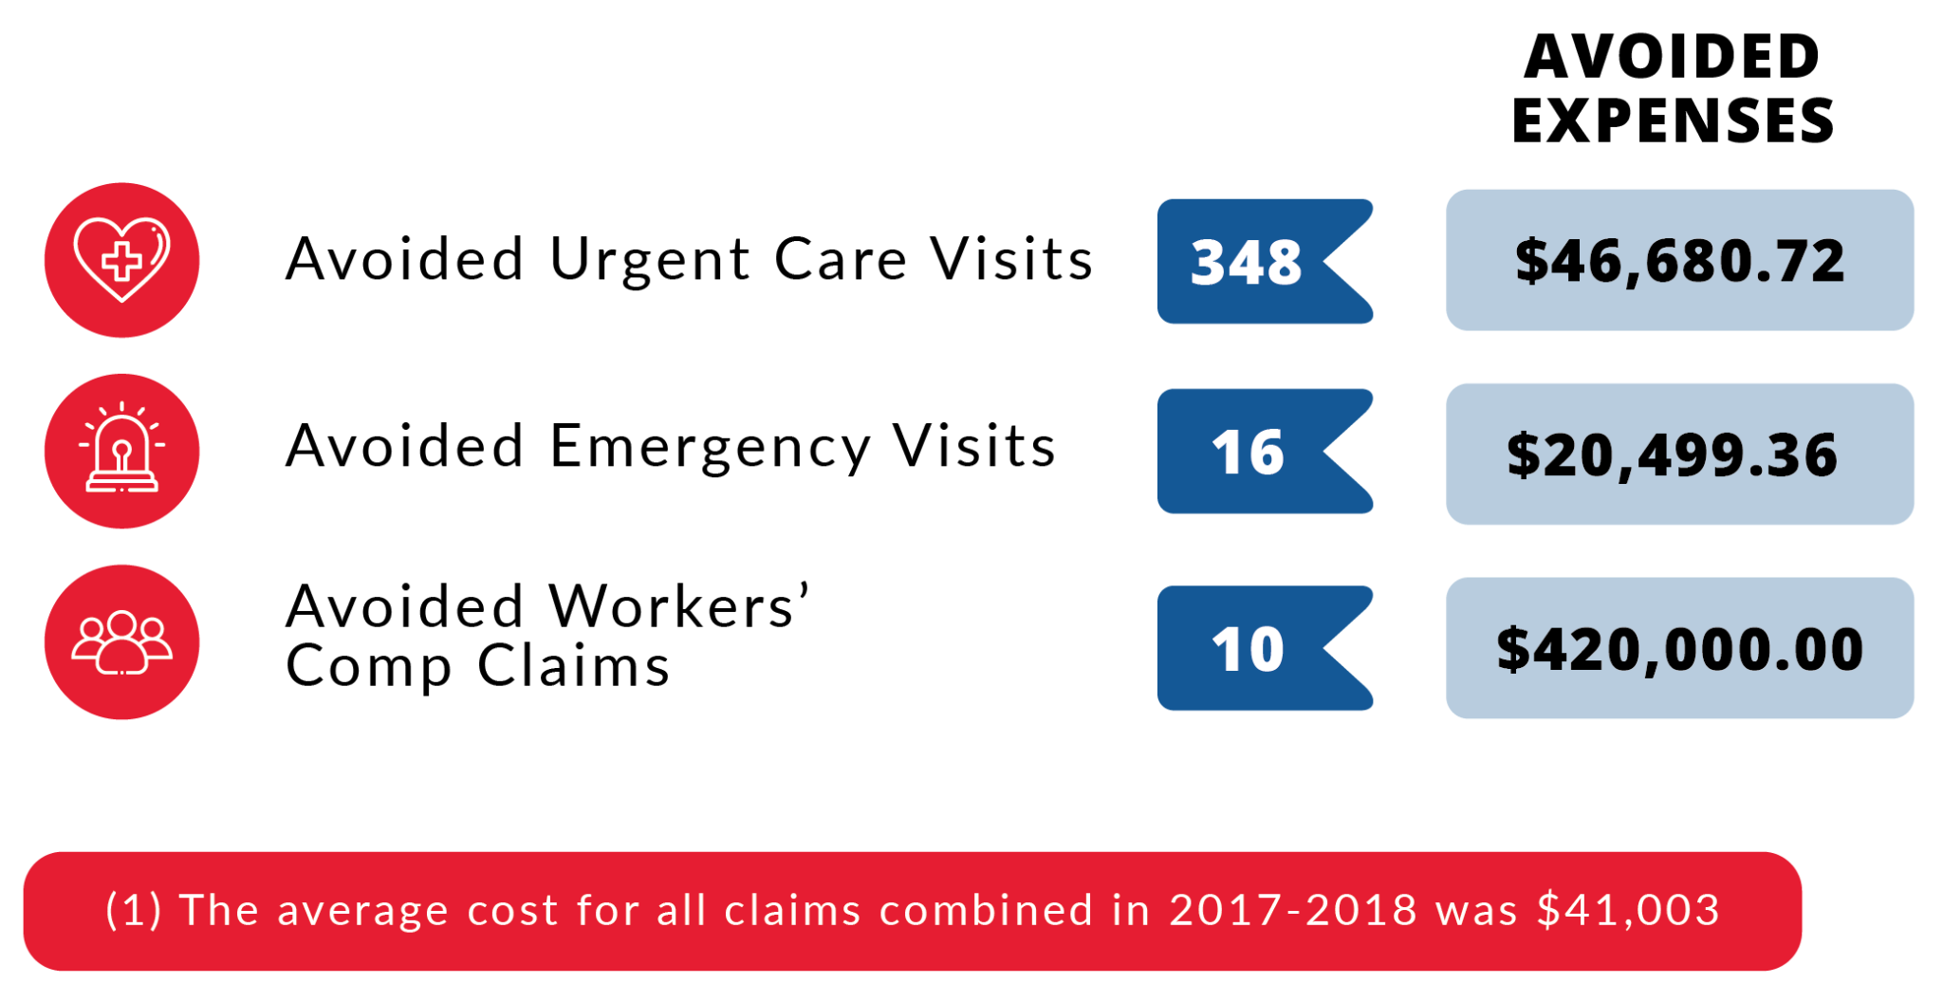
SAVINGS
Notes:
When a person has real access to a doctor, as opposed to having insurance, visits to the urgent care and ER can be avoided. The number of times this happened in this example is a judgement call at the time of care. A better way to calculate this would be to count the number of visits over the previous years and establish a trend and see what happens to the trend when direct care is used. We did not have access to this for this report. In the direct care agreement with this employer we were seeing injured workers as well which allowed for treatment of these cases without having to file a claim for reimbursement. In this approach, a zero-dollar claim is filed in order to notify the work comp carrier that there was an injury but there is no need to pay a claim.

Slide 10
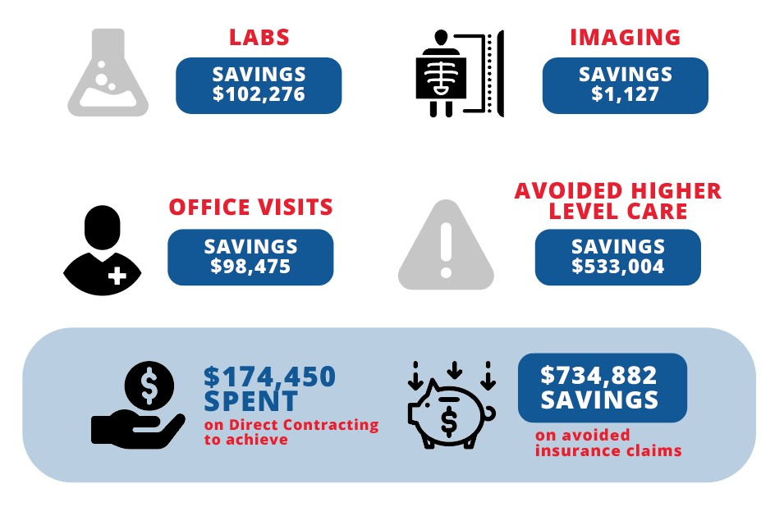
SAVINGS
https://directmedclinic.com/wp-content/uploads/2022/02/Lancer-Clinic-Report-Redacted-Version.pdf
Notes:
So in summary, through direct contracting for primary care, the employer paid $174,450 and realized an estimated $734,882 in savings compared to the traditional approach through insurance.
Antrea, let's make the detailed annual report available in the references.
https://drive.google.com/file/d/1Bi8LvBOTJeu6Lc-qPaMCe8ojYP0AIK6k/view?usp=sharing

Slide 11
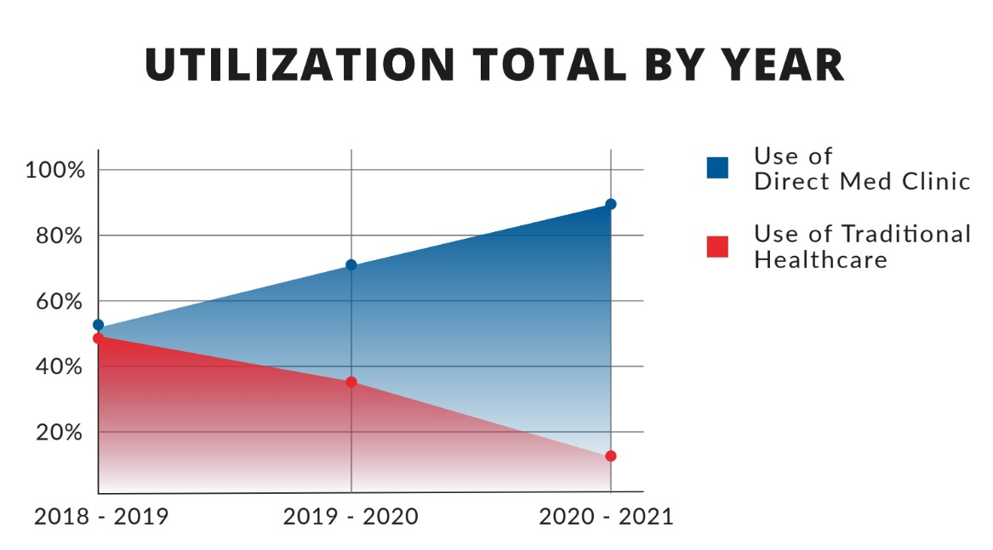
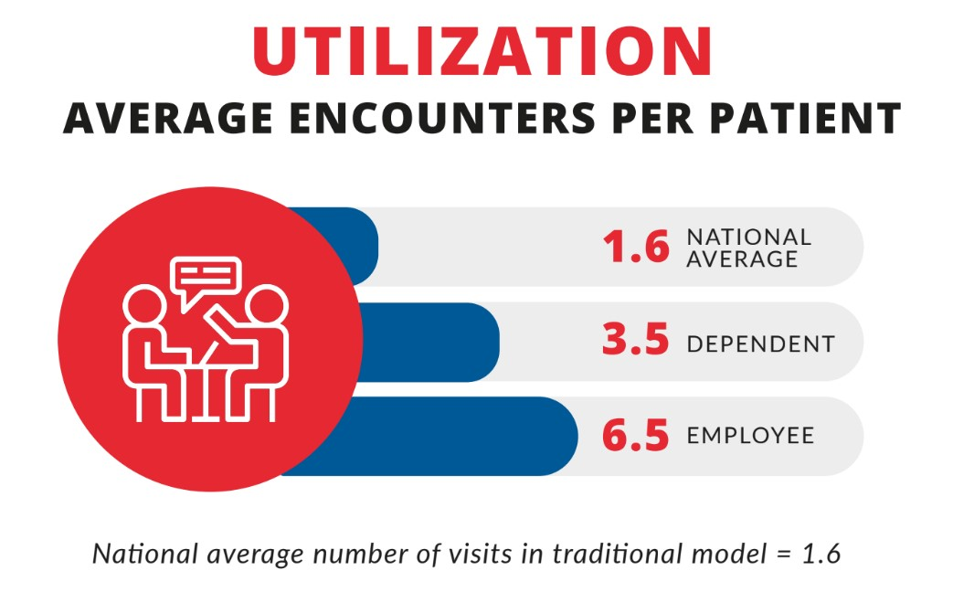
ACCESS TO CARE
Notes:
This is what access to care (or utilization) looks like with direct contracting. On average, DPC members are able to schedule an appointment with their DPC doctor within one day. They typically wait just minutes in the DPC office for scheduled appointments to begin, and spend as much time as they need to with the clinician. In my office, new patients are scheduled for an hour and follow up appointments are 30 minutes.
The graphic on the right shows the national average for encounters to be 1.6 visits per year. In this example, dependents had an average of 3.5 encounters at DMC and for employees it was 6.5.
https://www.soa.org/globalassets/assets/files/resources/research-report/2020/direct-primary-care-eval-model.pdf

Slide 12
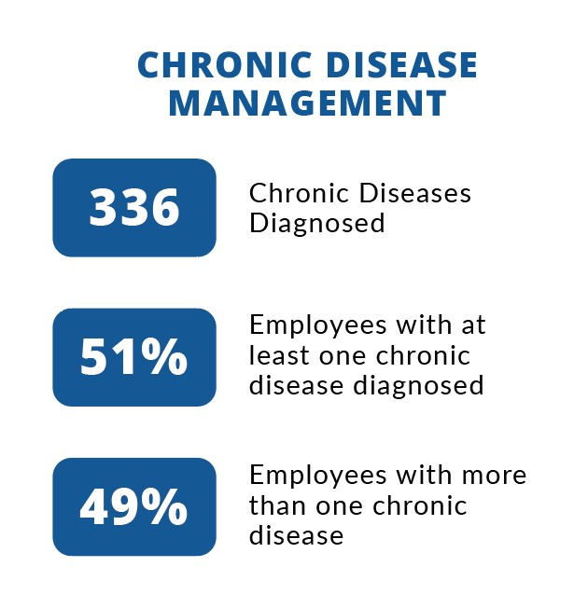
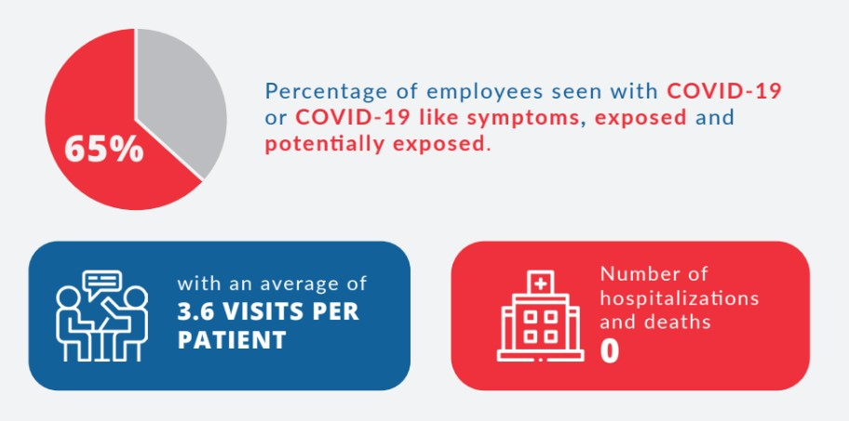
ACCESS TO CARE
Notes:
Since the employees of this company had no barrier to access to us during the pandemic, we urged them to let us know if they had covid, exposure to covid, what they thought were allergies, bronchitis or a sore throat or anything of the like. The results of this kind of access was that 65% of the workforce engaged with us with these concerns and we had an average of 3.6 virtual visits with each one. This resulted in no one going to the hospital and no one dying of covid.

Slide 13
Through 65 employers DMC provided affordable access to care for 1661 Texans without using their insurance
Notes:
Through a direct contract with the employer in the previous example and through other employers who purchased or offered DPC memberships to their employees, Direct Med Clinic provided care to 1661 Texans without using their insurance.

Slide 14
IV. Projected Results Based on Principles of Direct Care
We could touch 4,238,198 more Texans.
2019 Census, Texas data:
Number of employers with less than 50 employees = 825,226
Number of their employees = 4,238,198
Notes:
Data from the 2019 census shows that there are 825,225 companies with less than 50 employees. This corresponds to 4,238,198 Texans. All small employers struggle to provide health insurance for their employees because it is so expensive. Many of them do not provide any healthcare benefit at all. There is potential that through small employers, hundreds of thousands of at-risk Texans could be reached.
2019 census data indicates there are 825,226 firms with fewer than 50 employees in Texas. This corresponds to a total employment of 4,238,198 Texans. https://www.census.gov/data/datasets/2019/econ/susb/2019-susb.html

Slide 15
IV. Recommendations
Consider giving Medicaid beneficiaries an allowance to access to DPC
Consider giving state employees access to DPC coupled with an insurance plan for higher level of care when needed.
Consider was to incentivize small employers to provide DPC for their employees
Notes:
From my perspective I have personally seen and helped launch the TelaDoc model which was membership, or direct contracting-based model with employers, when it launched in 2004. I was founding consultant and medical director of DialCare when it launched which is also a direct care model. Now, from my example, I can see that a way to provide affordable access to care for hundreds of thousands of Texans is through small employers. It is to incentivize DPC, not insurance. We all have insurance for our car but we do not need it to change the tires. We all need insurance but we do not need it for primary care.

Slide 16
My testimony
I have created a place where a patient can have affordable access to care within the same day or next day and they know how much it costs and they do not fear any surprise bills.

Slide 17
My testimony
In this model I have repeatedly seen people give thanks for what we do and how we do it. It is my hope that members of this committee can experience the same praise from not only those who you will report to with your results but mostly from Texans who are suffering from lack of affordable access to care.

Slide 18
My testimony
I am confident that these basic principles, if implemented, can provide access to care to hundreds of thousands of Texans and set Texas apart as a model for how to provide affordable access to care and the members of this committee will be restoring trust in government to many who have lost that trust.

Slide 19
IV. Recommendations
D. Testimonials
And references

Slide 20
V. Resources
Testimonials
Links:
Annual Clinic Report
The Cost of Diabetes | ADA
Diabetes Quick Facts | Basics
Improving Healthcare Outcomes and Managing Costs (NJ could save up to $380-420 million w/DPC)
Direct Primary Care: Evaluating a New Model of Delivery and Financing
All Info - H.R.3436 - 117th Congress (2021-2022): Direct Primary Care Accessibility Act of 2021
H.R.725 - 117th Congress (2021-2022): Personalized Care Act of 2021

